Slide 1
Windows System Administration
Telerik Software Academy
academy.telerik.com
Virtualization
Borislav Varadinov
System Administrator
bobi@itp.bg

Slide 2
Virtualization Concept

Slide 3
What is Virtualization?
Virtualization is a term that refers to various techniques, methods or approaches of creating a virtual version of something

Slide 4
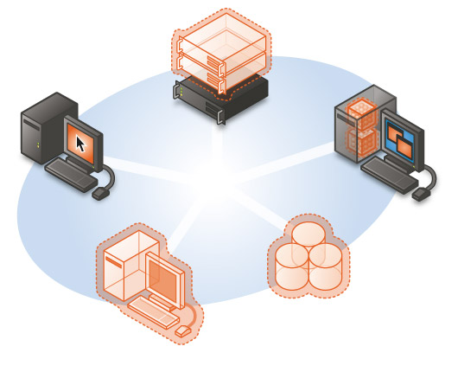
Virtualization Types
Virtualization Types
Server
Virtualization
Presentation
Virtualization
Hyper-V
Hyper-V Server
Virtual Server
Application
Virtualization
Remote Desktop Services
Microsoft
Application
Virtualization
Virtualization Management
System Center
Desktop
Virtualization
Storage
Virtualization
Virtual PC and Hyper-V Client
Hyper-V VDI
Storage Spaces

Slide 5
Why virtualization is important?

Slide 6
What problems do we have with classic environments?
Data centers are at capacity
Servers are under utilized
Legacy hardware and systems
Application compatibility issues

Slide 7
How Virtualization Will Help?
Server consolidation
Service or application isolation
Simplified server deployment
Increased service and application availability
Multiple operating systems can run on one consistent platform

Slide 8
Licensing
Some software solutions are not supported in virtual environment
Some software solutions require special license in virtual environment
Some software solutions comes with special virtualization use rights

Slide 9
Hyper-V

Slide 10
Hyper-V Role Overview
Server Role
Hypervisor-based full virtualization technology
Enables you to create a virtualized server or client computing environment
The Virtual Machine (VM) acts like a real computer with own operating system and applications

Slide 11

Hyper-V Server Overview
Microsoft Hyper-V Server
Windows Server Hyper-V
(Windows Role)
Microsoft Hyper-V Server
Hyper-V
Windows or Linux
Windows
or Linux
Windows
or Linux
Windows or Linux
Windows
Parent Partition
Parent Partition
Windows hypervisor
Windows hypervisor
Hardware
Hardware
Contains Windows hypervisor and other components, including base kernel and driver technologies.
Available as a role in Server Core or full installation of Windows Server

Slide 12
Hyper-V in Windows 8
The same computer virtualization technology that was previously available in Windows Server.
Supports Wireless network adapters
Supports sleep states and hibernation on laptops
How to Enable it ?
On the Control Panel, click Programs, and then click Programs and Features.
Click Turn Windows features on or off.
Click Hyper-V, click OK, and then click Close.

Slide 13
Hyper-V Requirements
Intel VT or AMD-V
Data Execution Prevention required:
Supported only on x64 processors

Slide 14
Hardware assisted virtualization
The modern x64 CPU’s include hardware assisted virtualization (Intel-VT and AMD-V)
G1 technology was introduced in 2005 (Intel-VT)
Makes it possible to support unmodified guests without emulation and instructions translation
Hardware Assisted Virtualization G2
Adds virtualization layer into the memory management unit

Slide 15
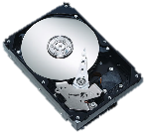
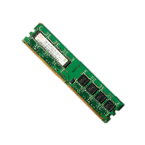
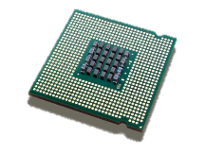
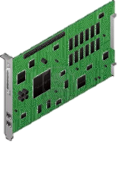
Hardware assisted virtualization
Applications
Applications
Applications
Applications
Applications
Ring 3
Win 2008
Win NT
Linux
BSD
Win 7
Ring 0
Hypervisor/VMM
Ring - 1
x64 Hardware

Slide 16
Hyper-V Architecture
Virtual Machine Bus (VMBus)
Virtual Server Client (VSC) drivers
Child Partition 1
Parent Partition
Virtual Service Providers (VSP)
Virtual Server Client (VSC) drivers
Child Partition 2
Virtual Server Client (VSC) drivers
Child Partition 3
Drivers
W i n d o w s H y p e r v i s o r
Server Hardware
Notes:
After the initial Windows Server 2008 R2 installation, the operating system can access the server hardware directly. After you add the Hyper-V role, a thin hypervisor layer between the operating system and the hardware resources is added. The currently installed operating system becomes the parent partition from where you can create and manage child partitions. Child partitions also do not have direct access to other hardware resources and are presented a virtual view of the resources, as virtual devices.
Drivers in the parent partition are used for accessing the server hardware. Child partitions use virtualized devices through virtual server client (VSC) drivers, which communicate through Virtual Machine Bus (VMBus) with virtual service providers (VSP) in the parent partition. Requests to the virtual devices are redirected either through the VMBus or through the hypervisor to the devices in the parent partition.
The VMBus manages the requests. The VMBus is a logical inter-partition communication channel. The parent partition hosts VSPs, which communicate over the VMBus to handle device access requests from child partitions. Child partitions host VSCs, which redirect device requests to VSPs in the parent partition through the VMBus.

Slide 17
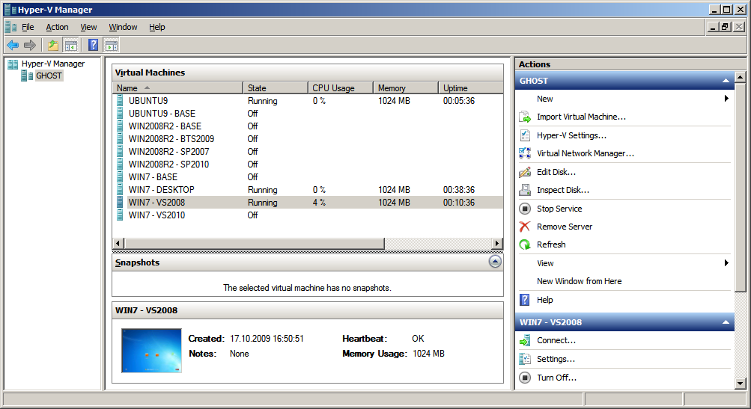
Hyper-V Manager

Slide 18


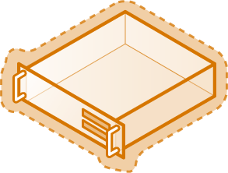
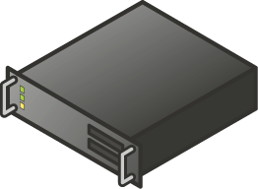


VM High Availability
Production LAN
Host 1
Host 2
Shared Storage

Slide 19

Live Migration
Production LAN
Host 1
Host 2
Shared Storage

Slide 20

Power Management
18:00
Host 1
Host 2

Slide 21
Snapshots
Snapshot
Snapshot

Slide 22
System Center Virtual Machine Manager

Slide 23
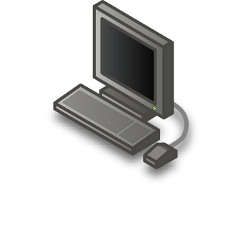
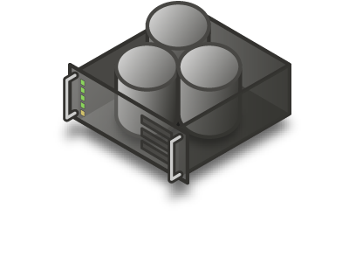



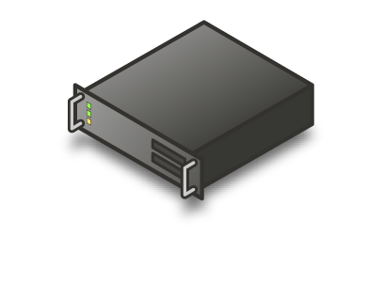


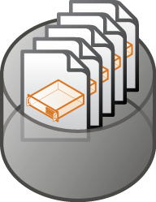
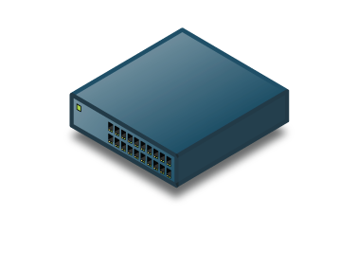
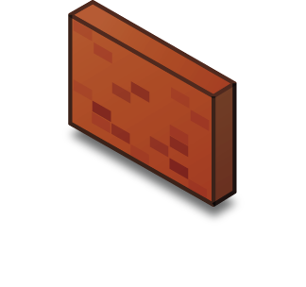


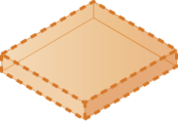
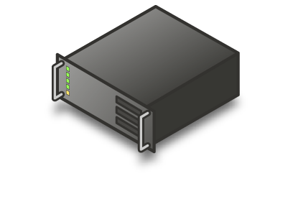

VMM Overview
Windows® PowerShell
Administrator Console
Web-based Delegated Provisioning UI
External Network (DMZ)
London
Singapore
Remote Library Server
Virtual Machine Hosts

Slide 24
VMM Overview (cont.)
Single-view for centralized control
Dynamic workload balancing
Provisioning Services
Role-based administration
Self-Service
Monitoring and Reporting
Integration with other systems

Slide 25







VMM 2012 Architecture
Administrator Console
Self Service Web Portal
Operations Manager
Management Group
Windows® PowerShell
Connector
Virtual Machine Manager
Server
Management Interfaces
WDS
WSUS
VMM Library
Server
Hyper-V
Cross Platform
ESX and XenServer
Hosts
VM
Template
VM
VM
VM
VM
VM
VM
VM
VM
ISO
VHD
Script
VM
VM
VM
VM
SAN Storage

Slide 26
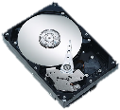
P2V
Virtual Machine
Physical Server
Virtualization Host

Slide 27
Remote Desktop Services
Presentation Virtualization

Slide 28
Remote Desktop Services (RDS) Overview
Server Role
RDS provides technologies that enable:
Users to access the full Windows desktop of a server
users to access Windows-based programs that are installed on a server
Server to host multiple, simultaneous client sessions
Five main architectural components

Slide 29
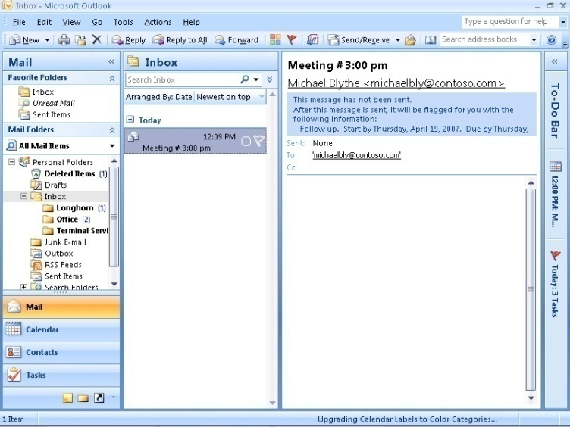
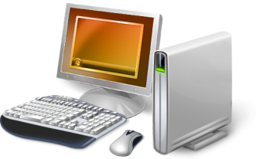
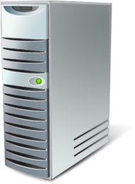
RemoteApp Overview
Remote Desktop Client
Remote Desktop Session Host Server
Notes:
RemoteApp provides the ability to run both local and remotely-hosted programs on a Windows desktop. These programs will be fully integrated with the local computer, having their own resizable windows and taskbar entries. The remote program is completely integrated with the user's desktop, and appears to the user as if it is running on the user's local computer. Users can run programs from a remote location side-by-side with their local programs. If the program uses a notification area icon, this icon appears in the client's notification area. Popup windows are redirected to the local desktop. Local drives and printers can be redirected to appear in the remote program. Many users might not be aware that the remote program is any different than a local program.
Aggregation of RemoteApp sources
In WS 08, TS Web Access can only point to one Terminal Server, or a farm of identically configured Terminal Servers.
In R2, RD Web Access can point to many RDSH servers or RDS farms.
Filtering of RemoteApp programs
Users only see the RemoteApp programs that are assigned to them.

Slide 30
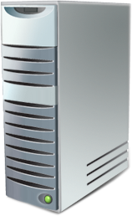



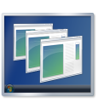


Remote Desktop Session Host
RemoteApp
Remote Desktop Client
Desktops
RD Connection Broker
Notes:
RD Session Host is the well known Terminal Services experience with performance and compatibility improvements to allow a more seamless user experience. RemoteApp application are also hosted using RDSH.
RDSH Server Role is installed on the Remote Desktop Session Server.
Applications are installed on the server
Multiple RDSH servers can be deployed along with a load balancing technology. Every server needs to be identically configured with the same applications.
User requests an application from their desktop. The RDP client connects to the RD connection Broker which provides the best server to connect to in the RD server farm.
If the Remote connection is interrupted the RD Connection broker can reconnect the user to the session they were last connected to.

Slide 31
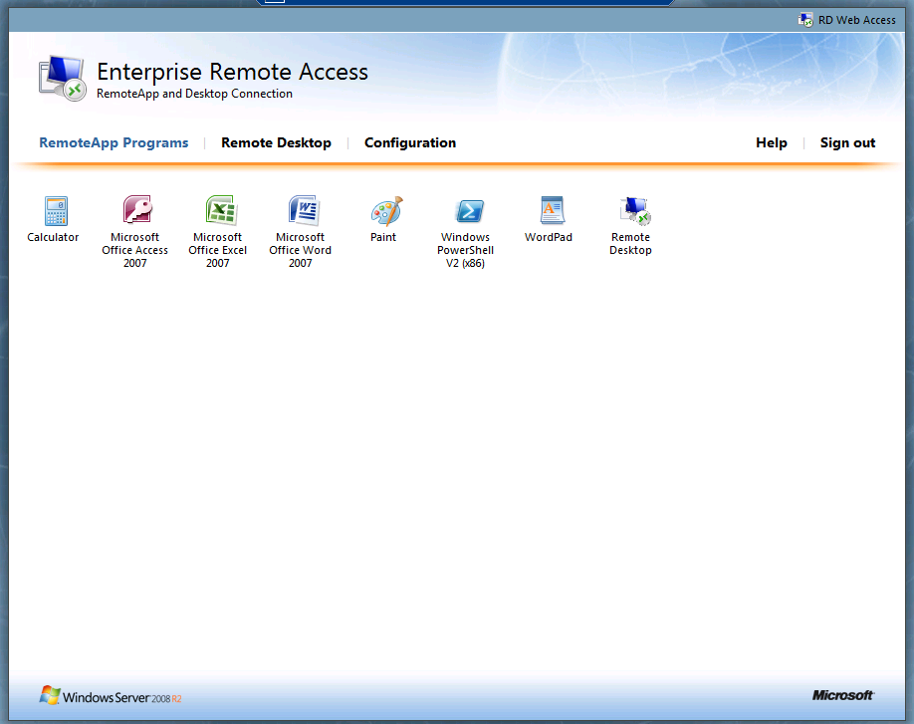
RDS Web Access

Slide 32





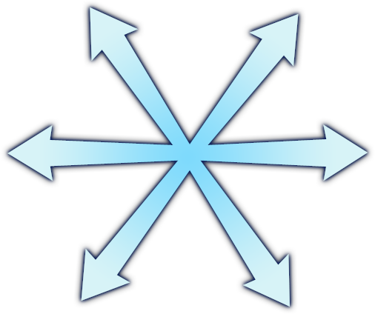


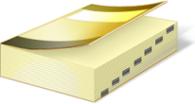


Full RDS Architecture
RD Web Access
RD Session Host
RD Client
RD Connection Broker
RD Gateway
RD Virtualization Host
Active Directory®
Licensing Server
Notes:
[Build 1] – The following slide provides a high level overview of the components in RDS. We will look at the new RDSH and RDVH technologies in depth later on.
Remote Desktop Session Host Server provides a similar set of functionality as Terminal Server.
RD Virtual Host Server is a hyper-v based server that is used to provide VDI functions.
RemoteApp and Desktop Web Access Server provides a web based interface for RemoteApp enabled applications as well as one click access to virtual desktops. Highlight that you need Windows 7 on the client to take full advantage of Desktop Connections.
RD Gateway to offer secure remote access to RDS servers and infrastructure
All components require an RDS licensing server
Permissions and policy is stored in Active Directory
[Build 2]
Remote Desktop Client gets connection information from the RD Web Access Server. If the client is outside the network the client connects through the RD Gateway server, if they are internal then can connect directly to an RDSH or RDVH server. In both cases the server that the client connects to is negotiated by the RD connection Broker. The connection broker plays a central role in RDS to make sure clients get connected to appropriate resources. It also helps clients reconnect to disconnected or interrupted session, and makes sure that clients are connecting to the correct servers for VDI resources.
At a high level the remote client uses the RD Gateway to obtain access to the RDSH RD Session Host and RDVH servers.
The RD Connection Broker connects clients to sessions and VMs on the RDSH and RDVH servers.
All Remote Desktop Servers require validation with an RD Licensing Server.

Slide 33
Virtualization
http://academy.telerik.com

Slide 34
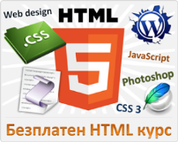



Free Trainings @ Telerik Academy
"Web Design with HTML 5, CSS 3 and JavaScript" course @ Telerik Academy
html5course.telerik.com
Telerik Software Academy
academy.telerik.com
Telerik Academy @ Facebook
facebook.com/TelerikAcademy
Telerik Software Academy Forums
forums.academy.telerik.com

